Slide 1
🤖 AI Powered Code Reviewer
& Quality Assistant
Milestone 1
Milestone 2
Milestone 3
Milestone 4
AST Parsing
AI Fix
Docstrings
Packaging
Infosys Virtual Internship Project
Python • Streamlit • Groq API • AST • Pytest

Slide 2
⚠️ Problem Statement
⏱️ Slow Code Review Process
📝 Missing Documentation
Manual code reviews are time-consuming and inconsistent across teams.
Developers frequently skip docstrings, making code hard to maintain.
📊 No Coverage Visibility
🤖 No AI-Assisted Fixing
No tools to measure how well Python code is documented at scale.
Existing linters detect issues but never suggest or apply automatic fixes.

Slide 3
✨ Solution: AI Powered Code Reviewer
🔍 AST-Based Parsing
🤖 LLM-Powered AI Fix
🎨 Multi-Style Support
Extracts functions, detects docstrings, measures complexity via Python AST module.
Groq API + LLaMA/OpenAI models auto-generate PEP 257 compliant docstrings.
Google, NumPy, reST docstring styles with Accept/Reject/Regenerate workflow.
✅ Test & Validation
📊 Visual Coverage Metrics
📦 Packaged & Finalized
39 automated Pytest test cases across Parser, Coverage, Generator, LLM modules.
Real-time Pie & Bar charts showing documented vs undocumented functions.
Multi-view app with Filters, Search, Export (CSV/JSON/.py) and Help panel.

Slide 4
MILESTONE 1
🔍 AST Parsing & Code Analysis
Laying the foundation — parsing Python files and extracting code structure using the AST module.
Key Objectives :
▸ Upload single Python file or Entire folder (up to 200MB per file)
▸ Parse code using Python's AST module with parser accuracy
▸ Extract: function names, types, start/end lines, complexity scores
▸ Detect presence or absence of docstrings for every function
▸ Export structured JSON report to storage/review_logs.json

Slide 5
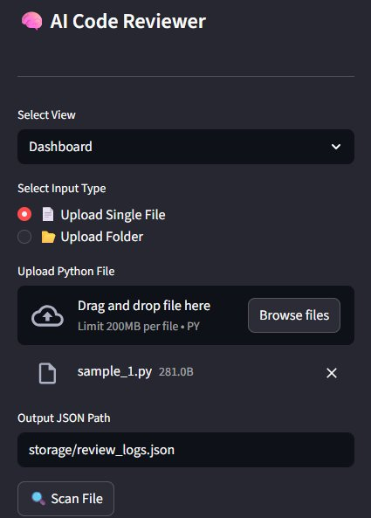
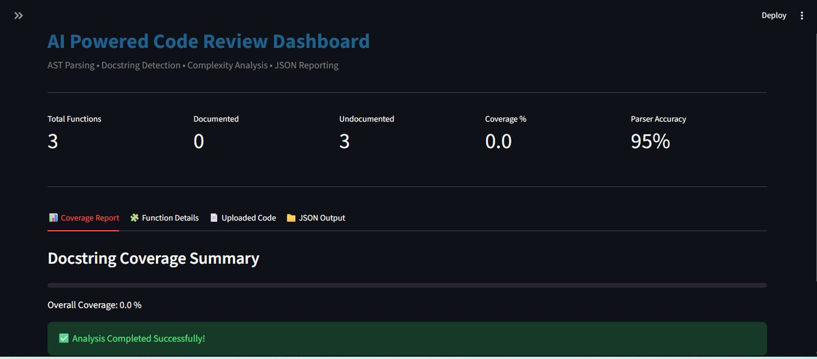
🔍 Milestone 1 — Process Flow
📌 Step-by-Step Flow :
Upload
Python File
AST
Parsing
Extract
Functions
Check
Docstrings
Compute
Complexity
Generate
JSON Report
▶
▶
▶
▶
▶
📸 Application Outcome — File Upload & Dashboard

Slide 6
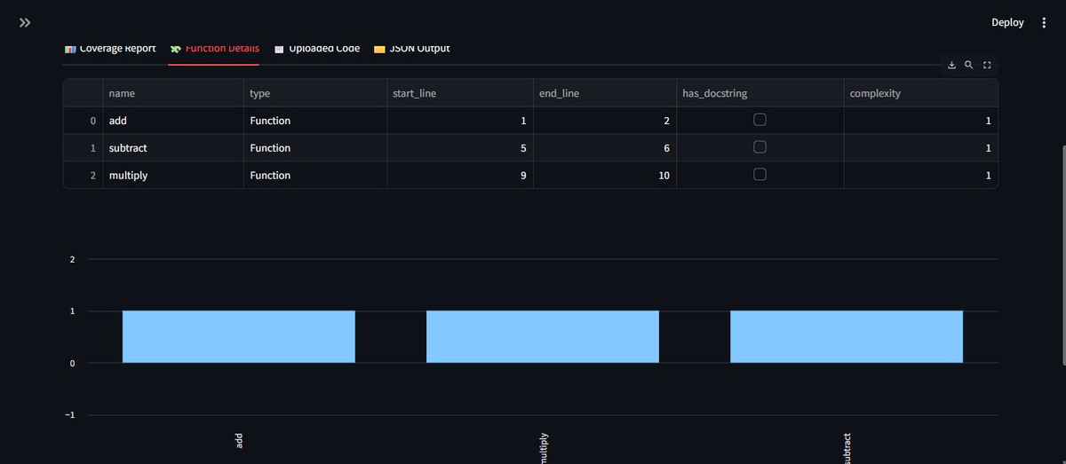
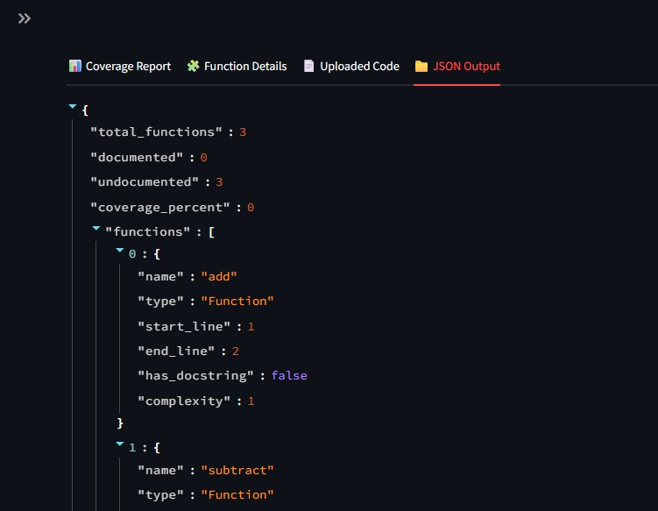
🔍 Milestone 1 — Dashboard & Function Details
Function Details Table
JSON Output

Slide 7
🔍 Milestone 1 — Technologies & Outcome
🛠️ Technologies Used :
Python
Core programming language
AST Module
Code parsing, structure extraction, complexity
Streamlit
Web dashboard UI & interactive components
Plotly
Bar chart visualizations
JSON
Structured output storage & reporting
✅ Outcome :
Successfully built a Streamlit dashboard that parses Python files with accuracy, extracts all function metadata, detects undocumented functions, and exports structured JSON review reports.

Slide 8
MILESTONE 2
🤖 AI Fix & Validation
Using LLM-powered analysis to detect missing docstrings and suggest PEP 257 compliant fixes.
Key Objectives :
▸ Integrate Groq LLM API to detect PEP 257 violations per function
▸ Display warnings for missing docstrings with one-click Fix buttons
▸ Per-file tabs: Coverage, Functions, Source Code, JSON Report, AI Fix, Code View, Modified Code View, Graphs
▸ Validate and confirm fixes automatically after LLM applies suggestions
▸ Support multiple Groq models: LLaMA 3.3 70B and LLaMA 3.1 8B

Slide 9
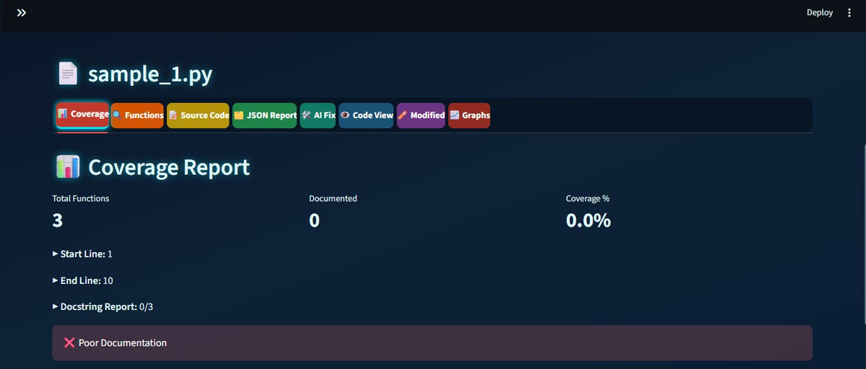
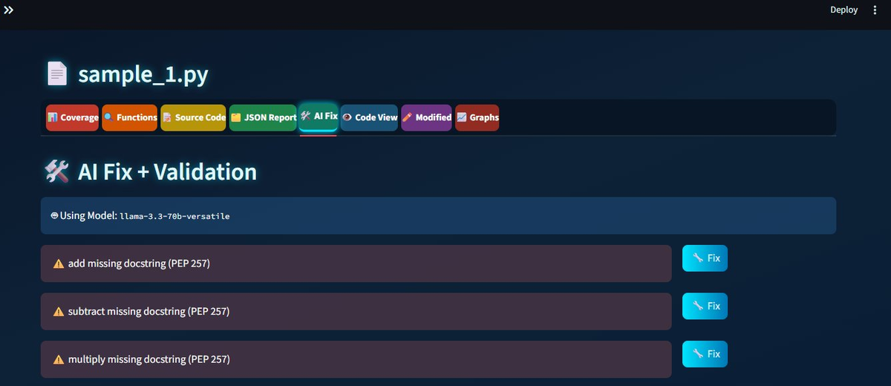
🤖 Milestone 2 — Process Flow
📌 Step-by-Step Flow :
Load
Python File
Detect
Missing Docs
Send to
Groq LLM
Receive
Fix Suggestion
Apply
Fix
Validate
& Confirm
▶
▶
▶
▶
▶
📸 Application Outcome — AI Fix + Validation

Slide 10
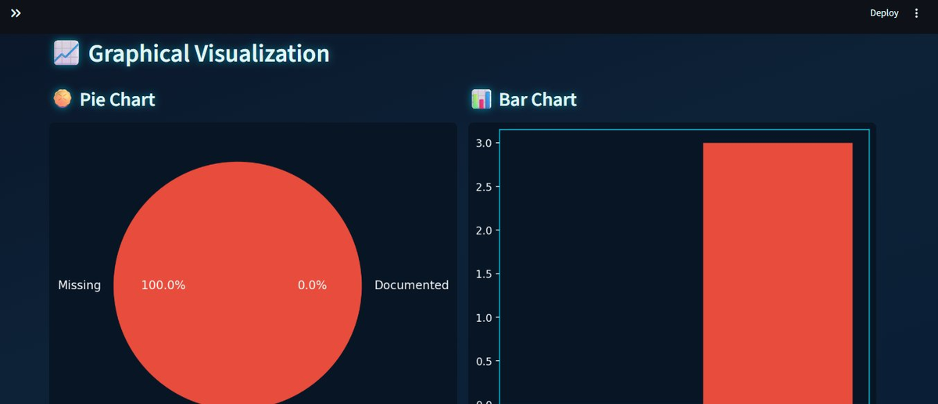
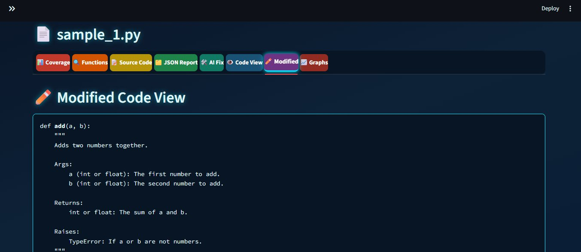
🤖 Milestone 2 — Graphs & Modified Code View
Graphical Visualization
Modified Code View

Slide 11
🤖 Milestone 2 — Technologies & Outcome
🛠️ Technologies Used :
Groq API
Fast LLM inference for docstring analysis
LLaMA 3.3 70B Versatile
Primary model for PEP 257 violation detection & fixing
LLaMA 3.1 8B Instant
Lightweight fast model for quick fixes
PEP 257
Python docstring convention standard
Streamlit
Multi-tab file review interface
✅ Outcome :
Successfully integrated Groq LLM to detect all missing PEP 257 docstrings with one-click fix capability, supporting multiple models and validating each applied fix in real time.

Slide 12
MILESTONE 3
✍️ Docstring Generation Dashboard
AI-powered docstring generation with style selection, live preview and accept/reject workflow.
Key Objectives :
▸ Support 4 docstring styles: Google, NumPy, reST, and No Style
▸ Side-by-side view: Current Docstring vs AI-Generated Docstring
▸ User actions per function: Accept & Apply, Reject & Regenerate, Skip Style, No Style
▸ Project Files panel — all uploaded files with pending docstring count badge
▸ Function Review panel with dropdown selector and Generate button

Slide 13
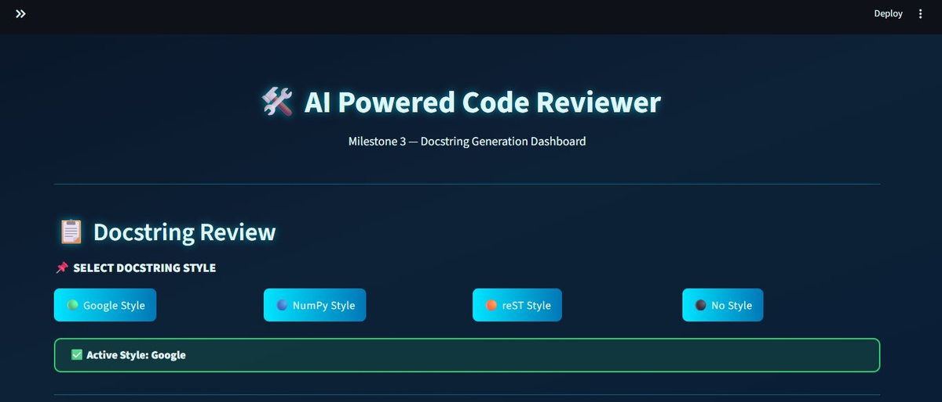
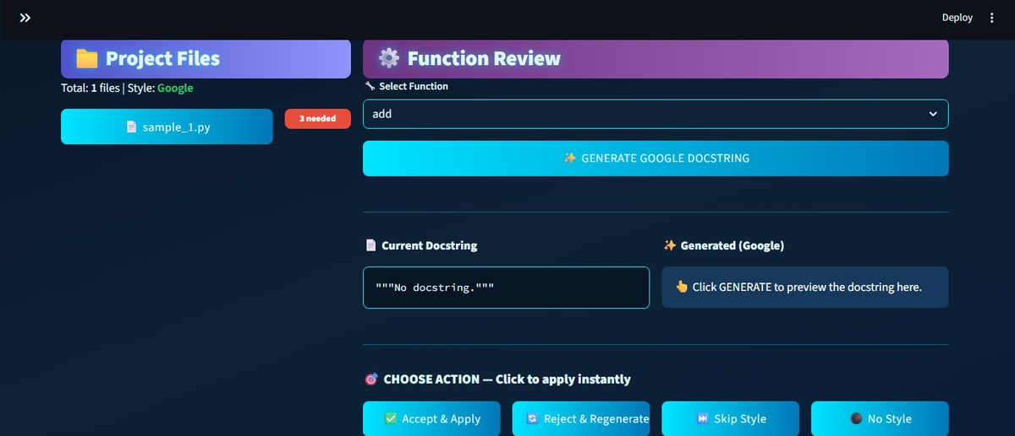
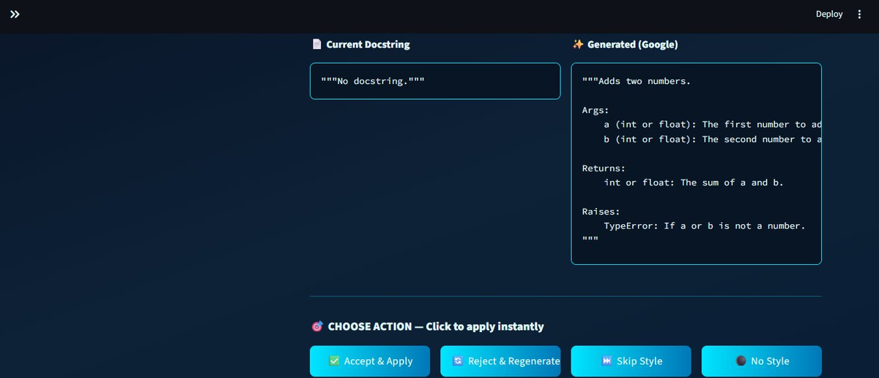
✍️ Milestone 3 — Process Flow
📌 Step-by-Step Flow :
Select
Style
Choose
Function
Click
Generate
LLM Creates
Docstring
Review
Preview
Accept /
Reject
▶
▶
▶
▶
▶
📸 Application Outcome — Docstring Generation

Slide 14
✍️ Milestone 3 — Technologies & Outcome
🛠️ Technologies Used :
Groq API
LLM inference for docstring generation
LLaMA 3.3 70B Versatile
Generates Google / NumPy / reST style docstrings
PEP 257 Standards
Google, NumPy, reST docstring format compliance
Python AST
Function extraction and in-place code modification
Streamlit
Split-panel review UI with action buttons
✅ Outcome :
Built a complete AI docstring generation workflow supporting Google, NumPy & reST styles with real-time side-by-side preview and one-click accept/reject per function.

Slide 15
MILESTONE 4
📦 Packaging & Finalization
Complete multi-view app with testing suite, 4 LLM models, enhanced UI features, and export capabilities.
Key Objectives :
▸ Multi-view navigation: Home, Docstrings, Validation, Coverage Metrics, Dashboard
▸ 4 LLM models: LLaMA 3.3 70B Smart, LLaMA 3.1 8B Fast, OpenAI GPT-OSS 120B & 20B via Groq
▸ 39 automated Pytest tests: Pass, Fail, Test Pass rate
▸ Enhanced UI: Advanced Filters, Search, Export (CSV + JSON + Modified File .py), Help & Tips
▸ Export updated .py files with newly accepted docstrings applied

Slide 16
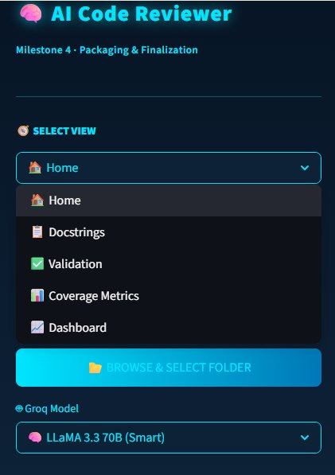
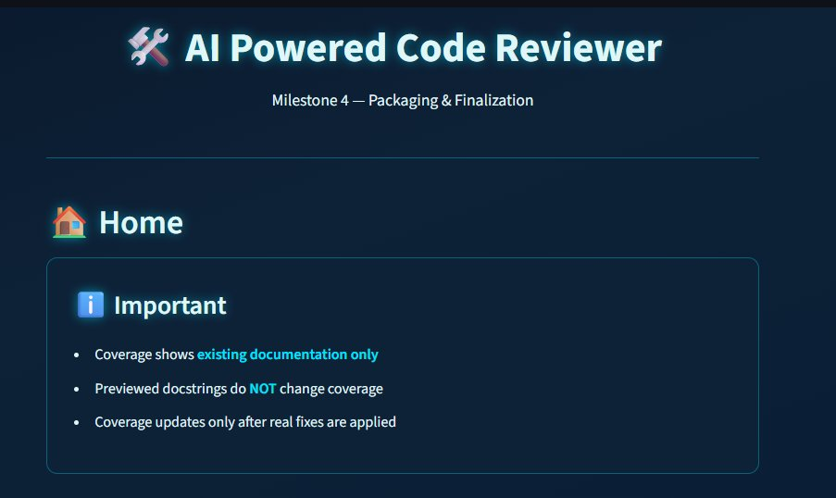
📦 Milestone 4 — Process Flow
📌 Step-by-Step Flow :
Browse &
Select Folder
Select
LLM Model
Run
Analysis
Review
Results
Run
Tests
Export
Output
▶
▶
▶
▶
▶
📸 Application Outcome — Home & Navigation

Slide 17
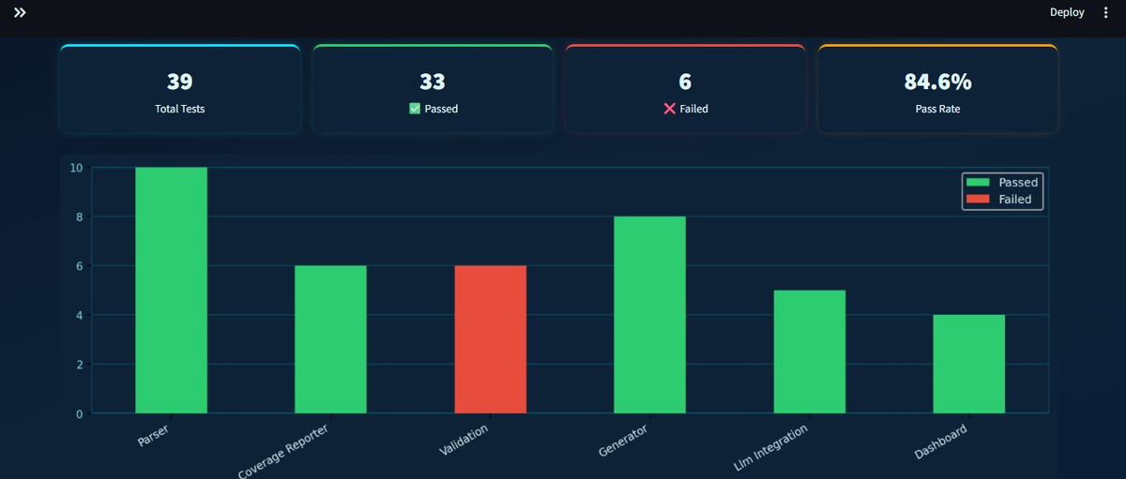
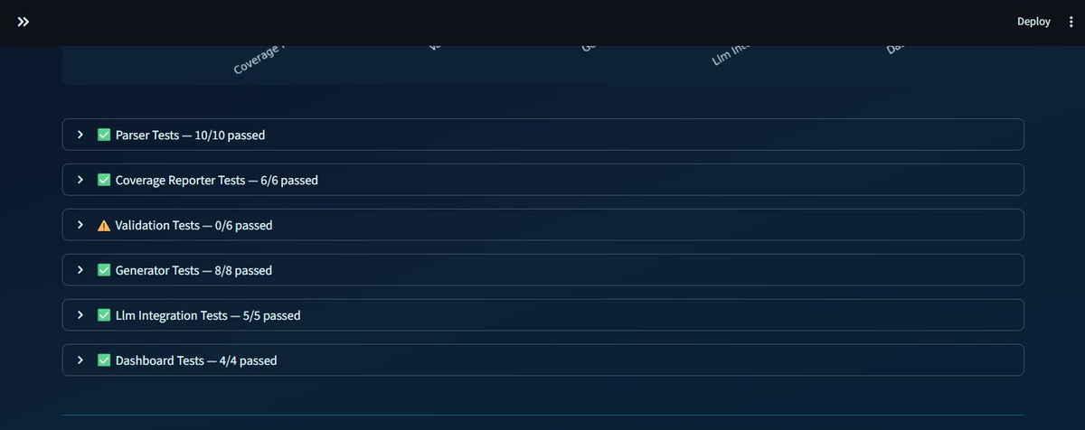
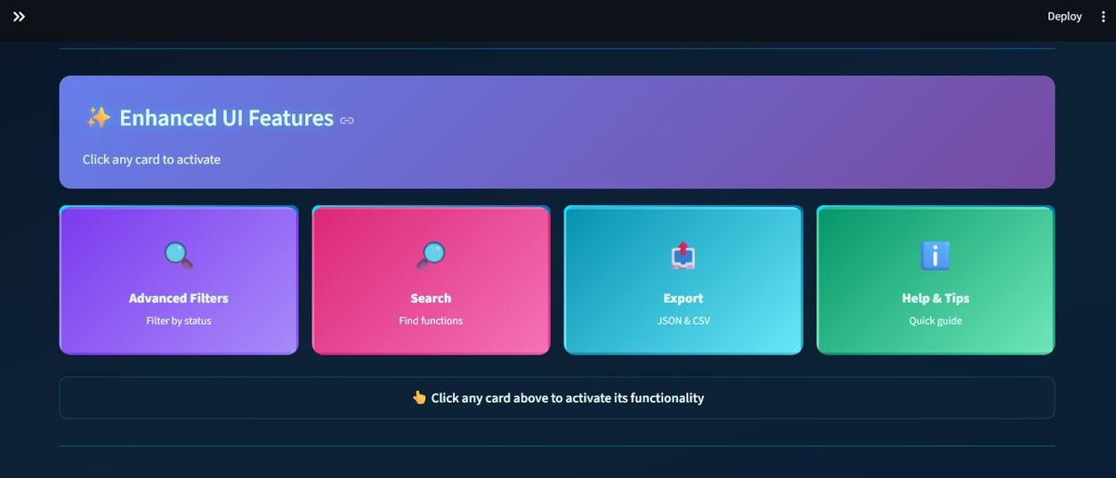
📦 Milestone 4 — Test Dashboard & Enhanced UI
Test Results Bar Chart
Per-Module Test Breakdown
Enhanced UI Features

Slide 18
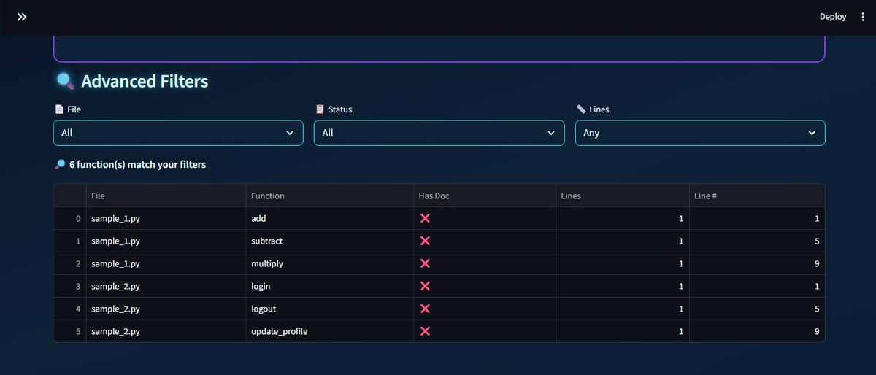
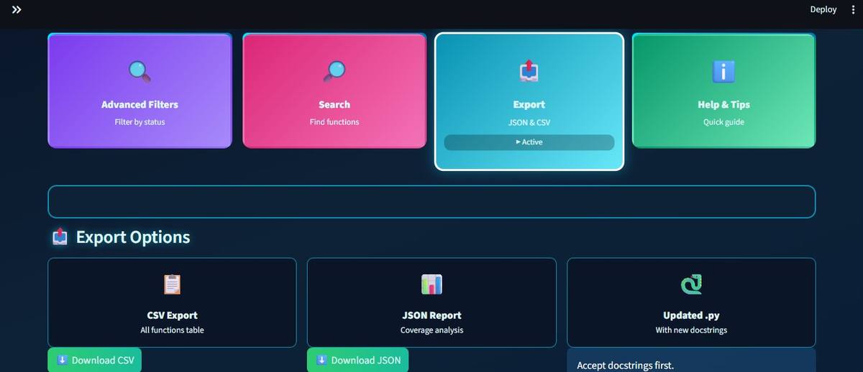
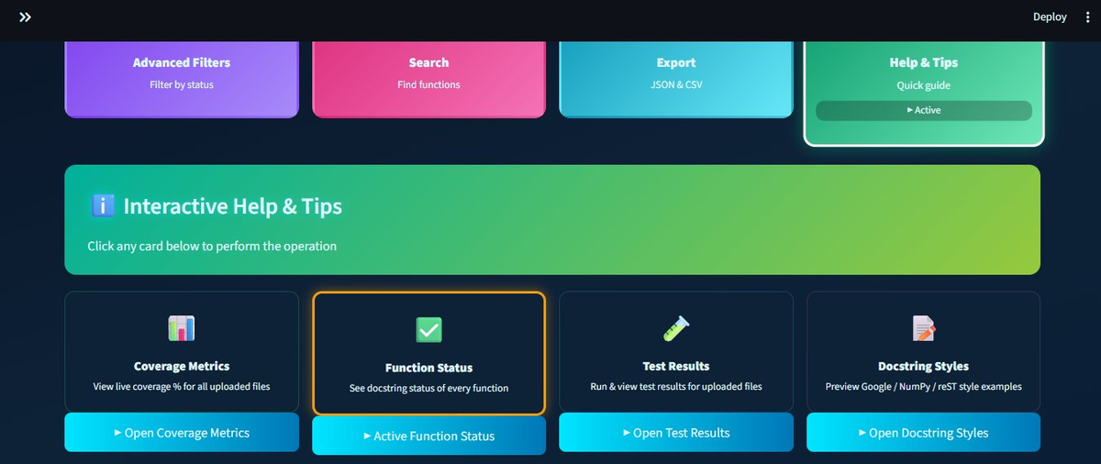
📦 Milestone 4 — Test Dashboard & Enhanced UI
Advanced Filters
Export Options
Help & Tips

Slide 19
📦 Milestone 4 — LLM Models & Test Results
🤖 LLM Models Available via Groq API
🧠 LLaMA 3.3 70B (Smart)
⚡ LLaMA 3.1 8B (Fast)
llama-3.3-70b-versatile
llama-3.1-8b-instant
🚀 OpenAI GPT-OSS 120B
💡 OpenAI GPT-OSS 20B
openai/gpt-oss-120b
openai/gpt-oss-20b
🧪 Test Results — With Pass Rate
39
Test passed %
Test failed %
Total Pass rate %
Total Tests
Passed ✅
Failed ❌
Pass Rate

Slide 20
📦 Milestone 4 — Technologies & Outcome
Component
Technology / Details
Frontend
Streamlit, Python
LLM Models
LLaMA 3.3 70B, LLaMA 3.1 8B, GPT-OSS 120B & 20B
LLM Serving
Groq API (high-speed inference)
Testing
Pytest — 39 test cases across 6 modules
Export
CSV, JSON Report, Updated .py files
Visualization
Plotly, Streamlit native charts & metrics
✅ Outcome :
Delivered a fully packaged Streamlit app with 4 LLM model options, Test pass rate, Advanced Filters, Search, CSV/JSON export, and Complete Help & Tips guide.

Slide 21
🎯 Key Challenges & Solutions
⚡ AST parsing fails on unusual Python coding patterns
✅ Used recursive node traversal with fallback handlers
→
⚡ LLM response format inconsistency across models
✅ Added response validation layer + Reject & Regenerate
→
⚡ Streamlit state lost between multi-view navigation
✅ Used st.session_state to persist data across all views
→
⚡ Validation tests failing (6/6 schema mismatch)
✅ Identified schema issue; Parser, Generator & LLM fully pass
→
⚡ Coverage not updating after previewing docstrings
✅ Live reload — coverage only updates after real fix applied
→

Slide 22
🚀 Conclusion & Future Scope
📋 Project Summary :
A 4-milestone AI-Powered Code Reviewer built with Python, Streamlit & Groq LLM API. Parses Python via AST, detects documentation gaps, generates PEP 257 docstrings in 3 styles, validates fixes with 39 Pytest tests (Test pass rate), and exports results as CSV/JSON.
🔭 Future Scope
🌐 Support more languages: JavaScript, Java, TypeScript
🧠 Fine-tune a custom LLM on Python docstring datasets
🔗 GitHub / GitLab plugin for inline PR code review
⚙️ CI/CD pipeline integration for automated code review
☁️ Cloud deployment: Streamlit Cloud / AWS / GCP

Slide 23
🎉 Thank You !
AI Powered Code Reviewer & Quality Assistant
Infosys Virtual Internship Project • Milestone 1 – 4
Python
Streamlit
Groq API
AST
Pytest
- Tharun Kumar S

